Slide 1
Notes:
weather=snow, rain, sunny, foggy
climate=describes weather patterns (dry, cold, humid)

Slide 2
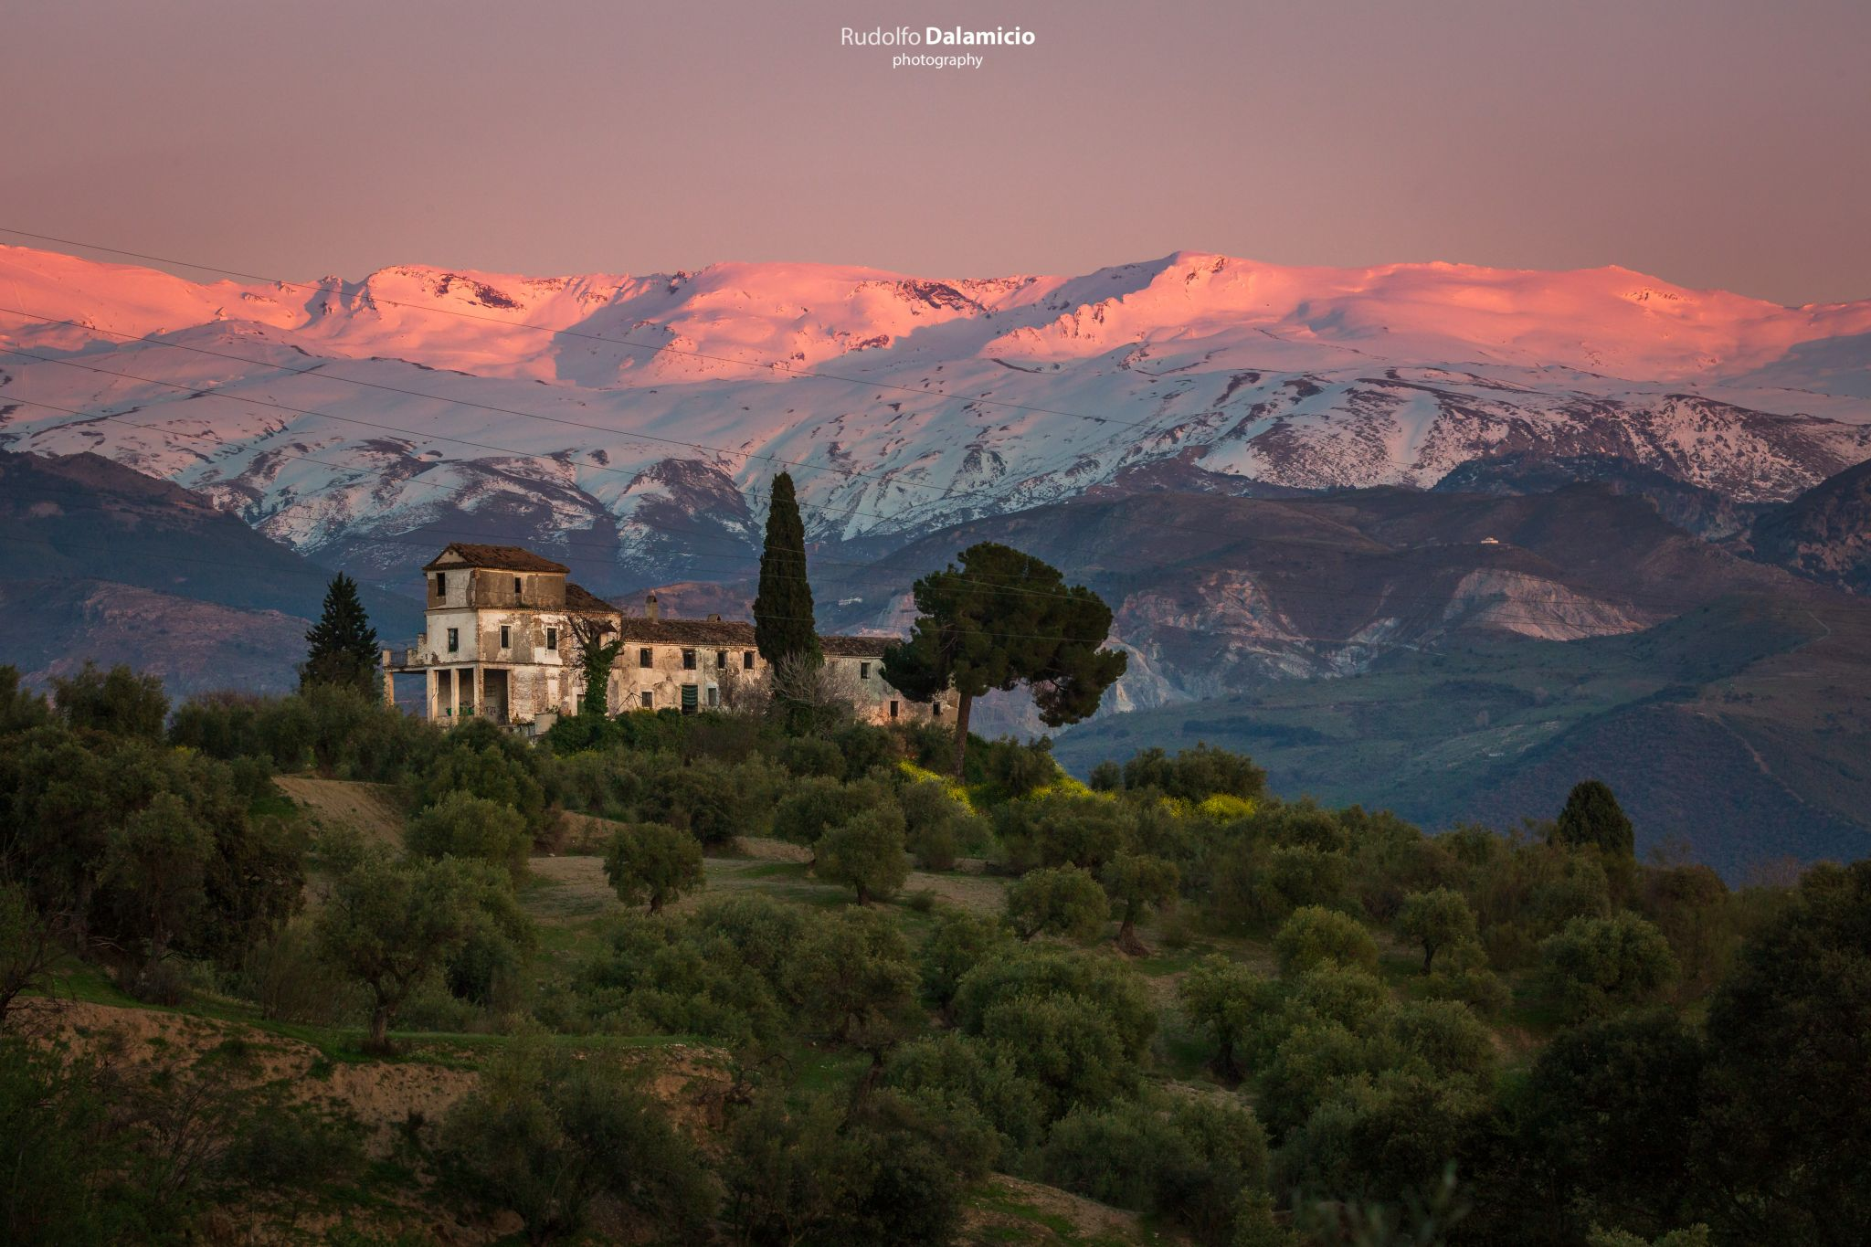
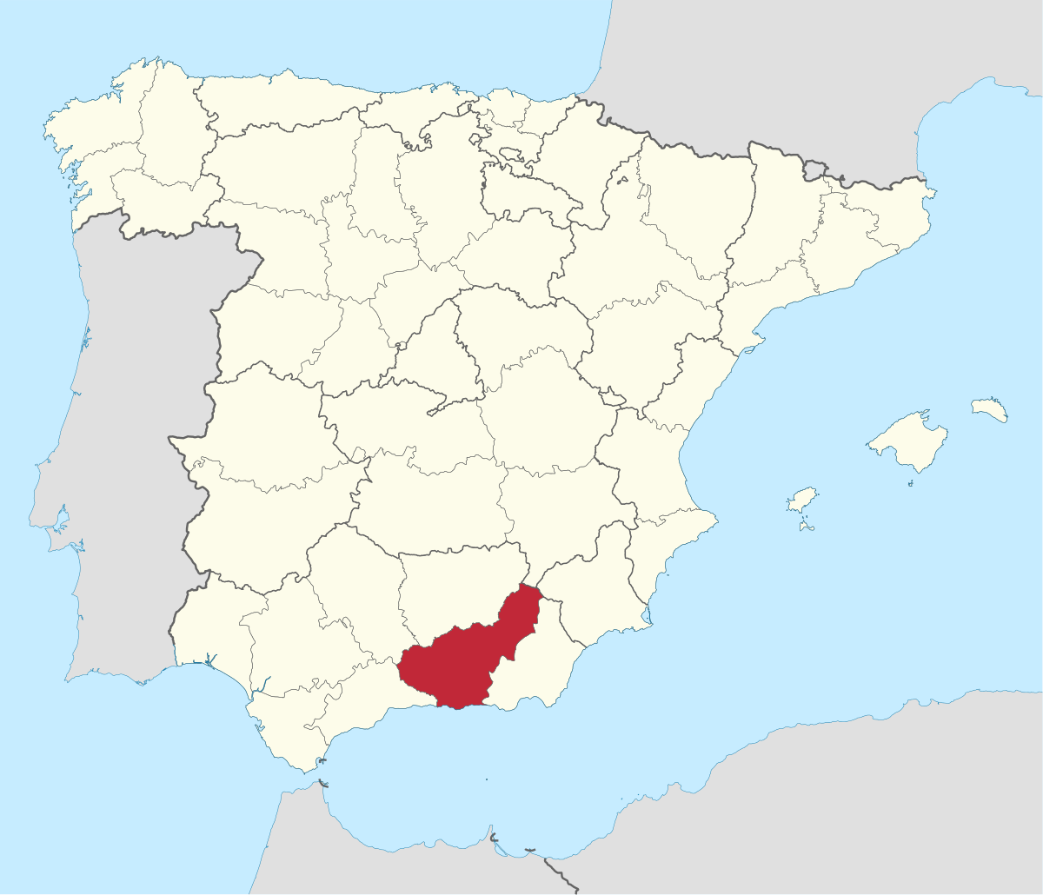
Mountain Climate
Cool summers
Cold winters
Abundant precipitation
Sierra Nevada, Granada

Slide 3
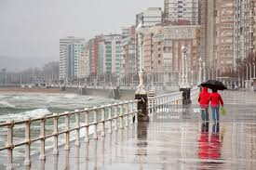
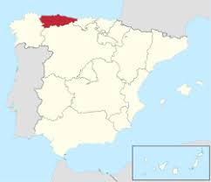
Oceanic Climate
Mild temperatures all year round
Abundant precipitation
Gijon, Asturia

Slide 4
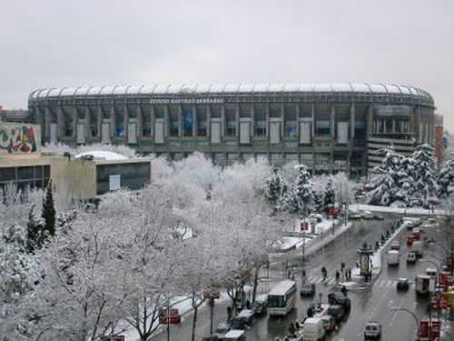
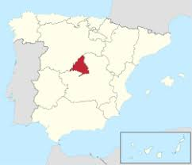
Continental Climate
Cold winters
Hot summers
Estadio Santiago Bernabéu, Madrid

Slide 5
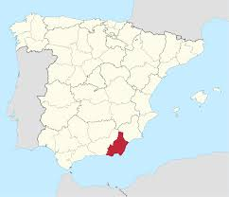
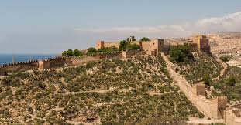
Mediterranean Climate
Mild Winters
Hot Summers
Irregular and low precipitation
Almería, Andalucia

Slide 6
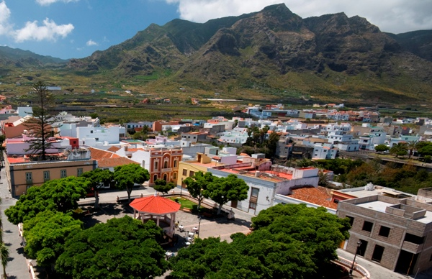
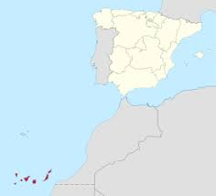
Subtropical Climate
Mild or warm temperatures all year round
Low precipitation
Tenerife, Canary Islands

